Slide 1
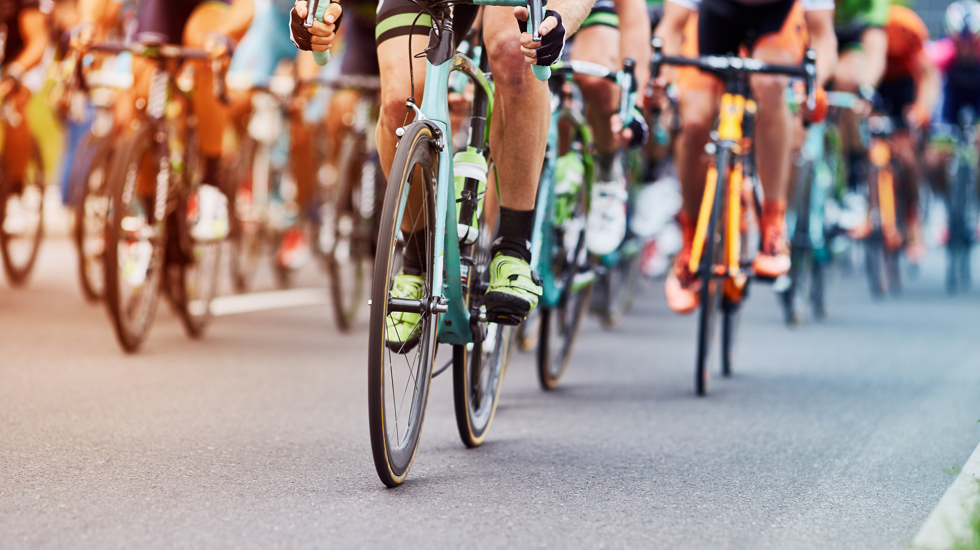


Rainbow Riders
LGBTQ+ cycling in Greater Manchester
Annual General Meeting 2023

Slide 2
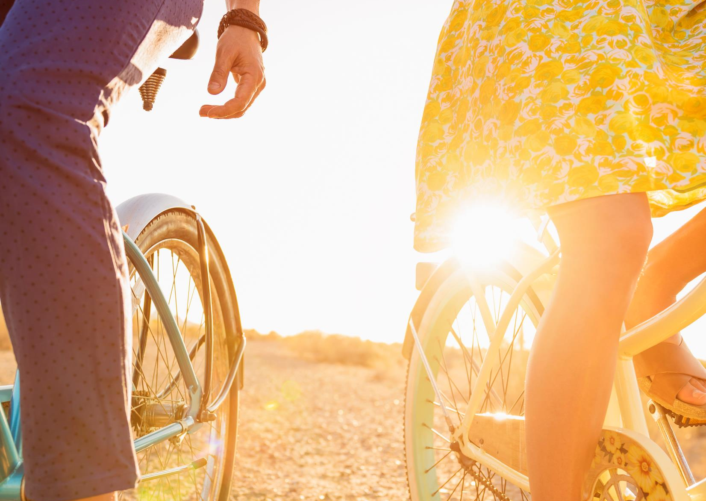
Where we are now
Following the disappearance of PrideOut, Bex, Kevin and Zach got together in October 2022 to see if they could try and revive an LGBTQ+ cycling club in Manchester and continue rides that were inclusive for all genders, abilities and ages etc.
We held our first ride in November 2022 to Tatton Park – winter wasn’t the best time to start an outdoor cycle club, but interest was kindled, and we carried on.
In May 2023, we had held more cycle rides and socials, and participant numbers were growing, we formed a steering group to help us navigate the next stages in the growth of the club like insurance and a website etc.
Now in December 2023, just over a year since Rainbow Riders was formed, we are looking forward to our next steps

Slide 3
Social Media
Growth on socials has been reasonable X (twitter) and Threads have the lowest followers. Instagram and Facebook remain the strongest platforms.
We have followers from other LGBTQ clubs in the UK and across the world.
We post a notification about each ride in advance and share a photo or video of the event after.
Future plans would be to highlight a full month of events in advance
Platform | 2022 | 2023 | DOC
Spond | 56 | 64 | Growing
Facebook | 68 | 81 | Growing
Instagram | 140 | 202 | Growing
X (Twitter) |  | 39 | Growing
Threads | 33 | 44 | Growing

Slide 4
Ride statistics 2023
By end of December 78 events we have held
  33 rides including social paced and road rides
  11 Critical Mass ride outs
  23 socials including theatre trips and First Friday Frolics
  8 events like Tour de Manc and Rapha Women's 100
  1 cycle tour of The Netherlands
209 attendances so far - 3 attendees per ride
Just 6 cancellations (8% of all events)

Slide 5
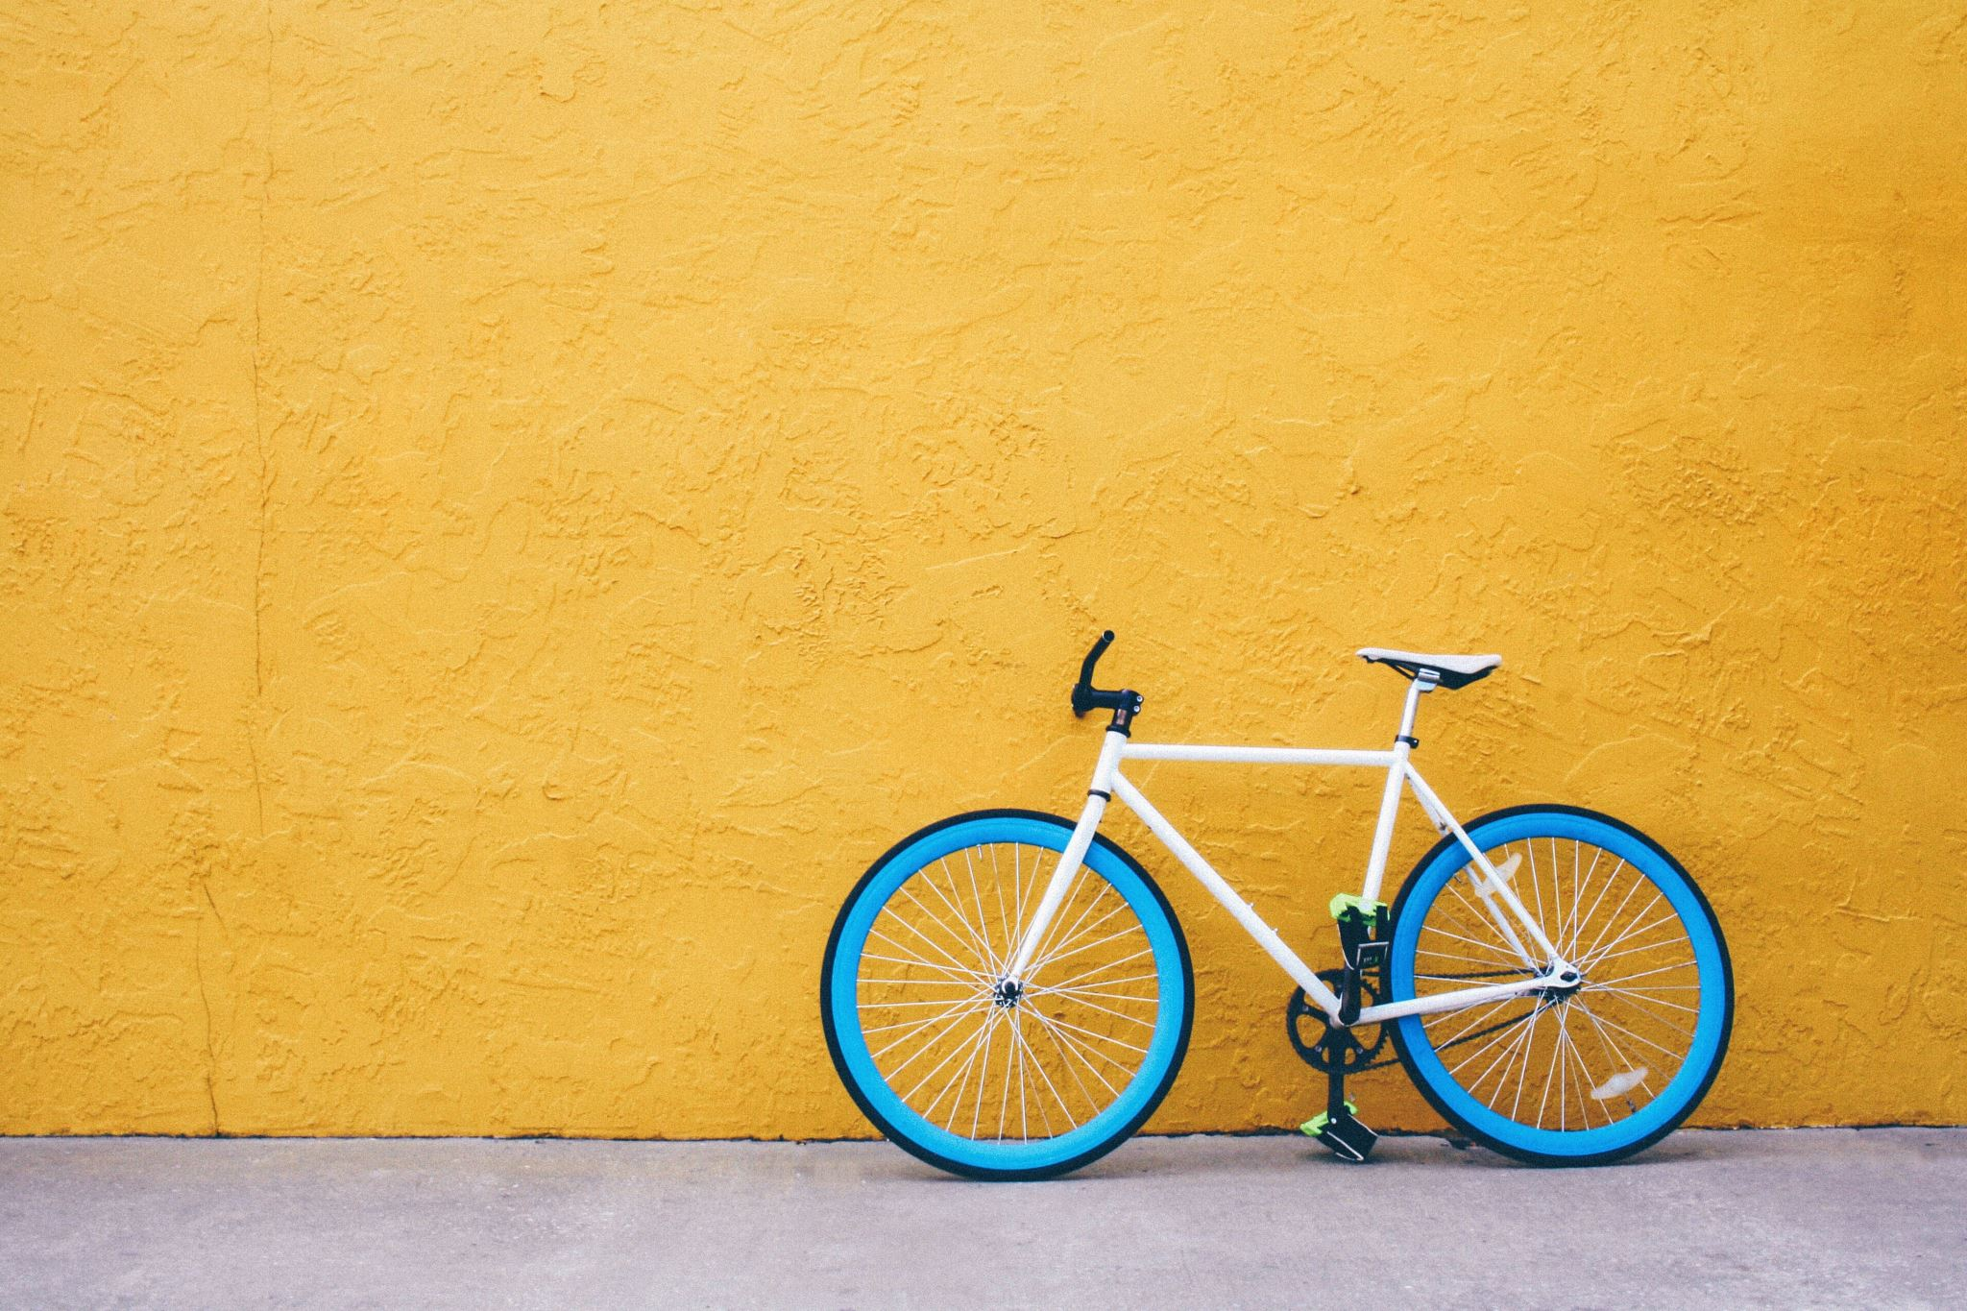
Finances
Zach Butcher (interim Treasurer)
At the club set up meeting in May 2023, 11 members pledged £10pp to kick start the Rainbow Riders.
We used this money to pay for insurance with CycleUK.
There were some other small donations through sales of rainbow lottery tickets
We had some t-shirts made for group socials like pride which generated a modest return
Zach had originally bought the website domain prior to the group officially forming costs for this are not included in the finances but total C.£50

Slide 6
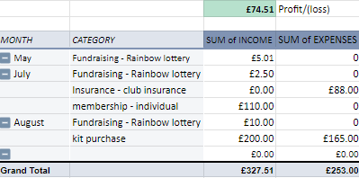
Finances (continued)

Slide 7
Finances (continued)
Future costs we expect to incur…
October 2024 will see the domain and web address renewal and is estimated at £50
2024 club insurance is estimated at £88
Entry in the Manchester Pride parade should remain free but if we want a presence at other events, we will need some marketing like a feather flag etc.
Q&A

Slide 8
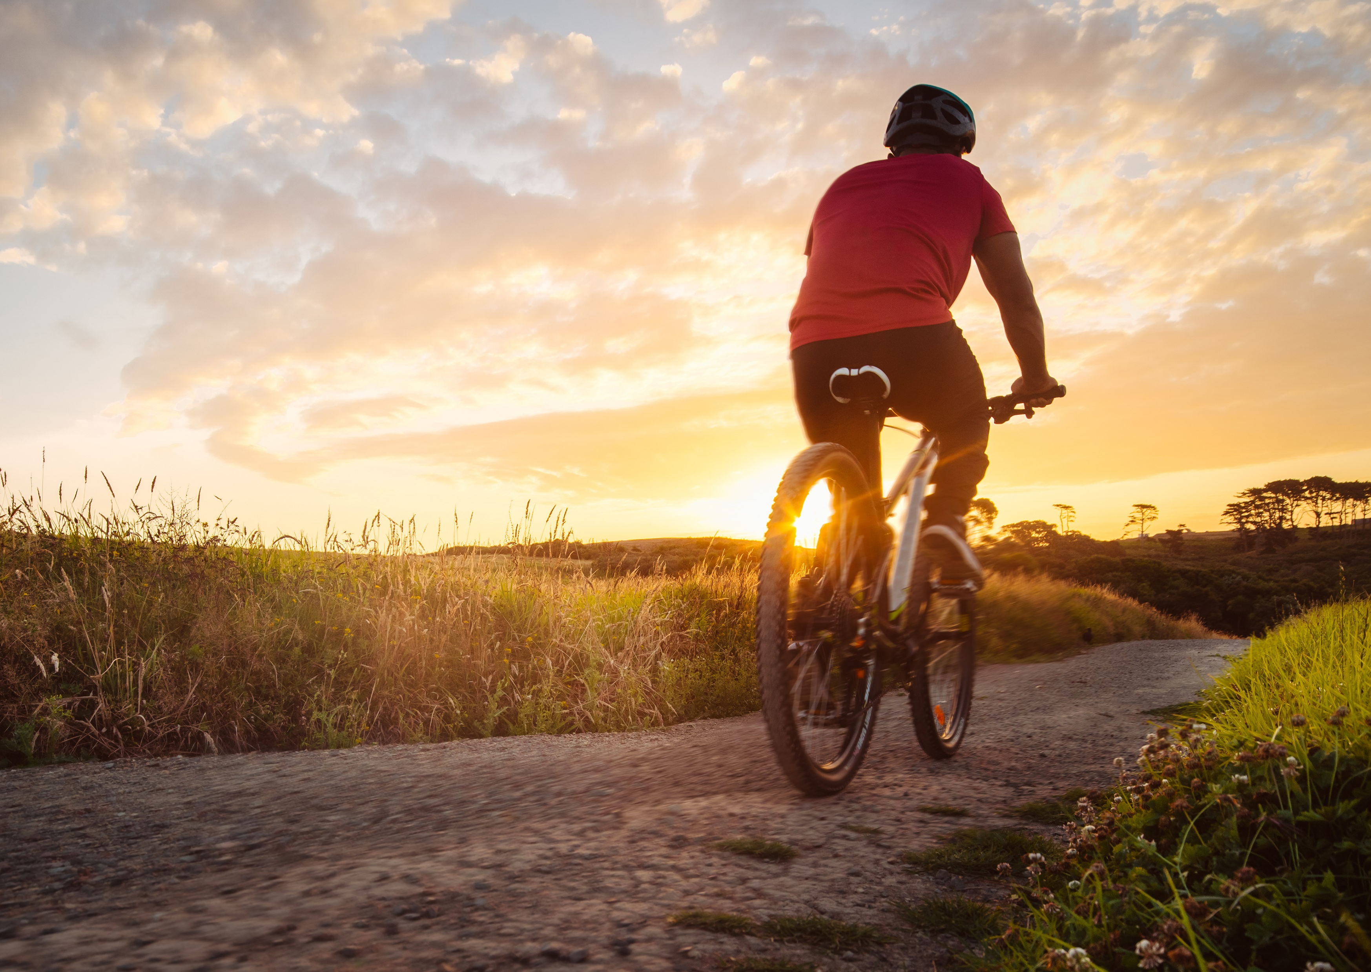
Rainbow Riders club constitution
Kevin Colley (interim Secretary)
The steering group have worked collectively to pull together a constitution for the club that does details the aims and objectives of the club and details the governance etc.
Core committee roles and responsibilities – who can be on the committee and term of service and how to be elected on to the committee
Details the frequency of general meetings, ride leader meetings, AGM and EGM
Finances, expenditure including purchasing power and expenses.

Slide 9
club constitution Q&A
A question was raised around a point in the constitution allowing the committee to amend the document without an AGM/EGM – it was clarified that the changes the committee could implement were small corrections not wider changes that would affect the running of the club.

Slide 10
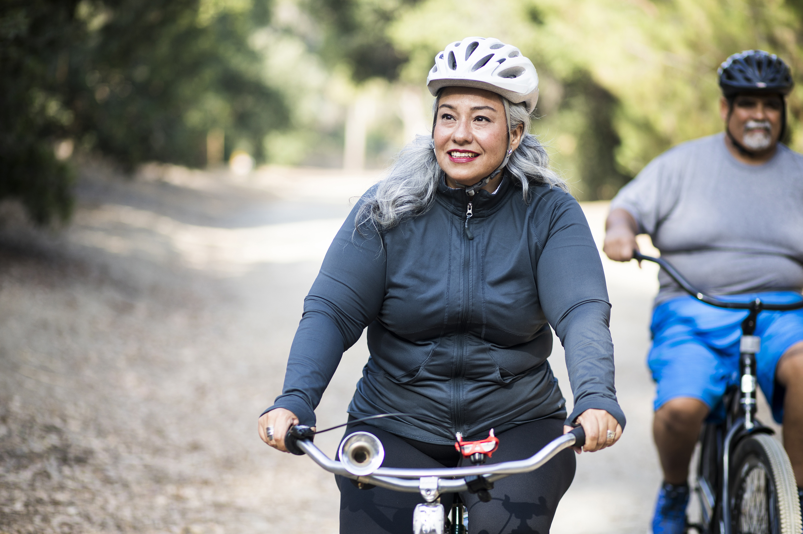
Nominations for the committee
The following roles are up for election tonight
Chairperson
Secretary
Treasurer
Inclusivity & Safeguarding officer
Ride and Events Coordinator
An online votes was held to approve each uncontested nominee or to vote between multiple nominees for each role.

Slide 11
Your elected committee members are:
Chairperson: Zach Butcher (he/him)
Secretary: Rhianne Naisbitt (she/her)
Treasurer: Bex Davenport (she/her)
Inclusivity & Safeguarding officer: Jack Dranfield (he/him)
Ride & Events co-ordinator: Josh Joshi (he/him)

Slide 12
What comes next
We will produce a short- and long-term plan to achieve some realistic goals around increasing membership and diversity of rides offered.
Your Ride & Events co-ordinator will help to develop a full calendar of rides for the coming year.
We are waiting to hear from grant funding application from the GM walking and wheeling fund to run an engagement programme over winter to encourage winter cycling.
We will look at trying to establish a presence at some of Greater Manchester prides in 2024

Slide 13

Finally…
A big thank you to the steering group that have laid the foundations over the last year, which will allow us to grow as a club in the future.
Thank you for your attendance and participation at the AGM. Please reach out to any of the committee directly if you want help or to discuss anything: rainbowridersuk@icloud.com
We all look forward to riding with you on more rides in 2024

